Slide 1
HRDC AUTOMATION SYSTEM
Prepared by - Dhruv Kava(18CE041)

Slide 2
INTRODUCTION
We are creating HRDC Administration Project which involves registration of users in events and workshops .also this Project useful for admin side, where admin can create & Schedule Event and after this also admin get the details of event, admin get details of participant and also admin can saw all the event and print and create pdf of all this module.
There are mainly two modules Admin and users.
In this user module, the colleges suggest the events and workshops for participation of users. This involves registration of events and workshops from different colleges. And users register into events and workshop for taking part.

Slide 3
PURPOSE
Purpose of HRDC system is to automate each and every event task of HRDC members, where by using this software they can easily generate their HRDC event and share the event details to teaching ,non teaching and management participants. Software will helps to create central data repository where each event schedule details, participant details, attendence details, expert details will be stored at one end.

Slide 4
TECHNOLOGY USED
Operating System : Windows
Source Code Editor : Visual Studio Code
Front End : HTML, CSS, PHP, xml
Back End : PHP, SQL
Database : MySQL via phpMyAdmin

Slide 5
FEATURES
Schedule Event
Participate in Event
View Events
Event Details
Attendence Details
Participant Details

Slide 6
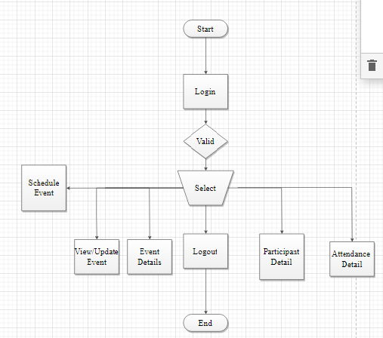
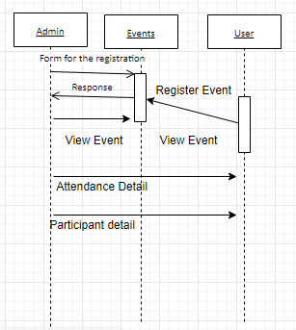
FLOWCHART

Slide 7
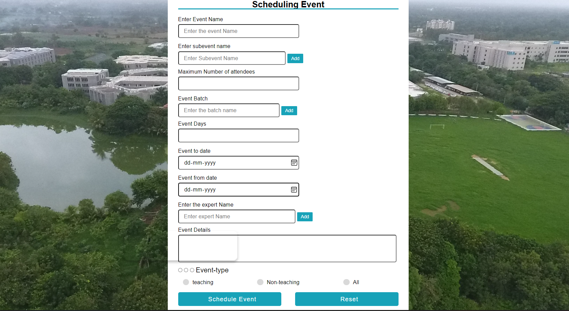

Slide 8
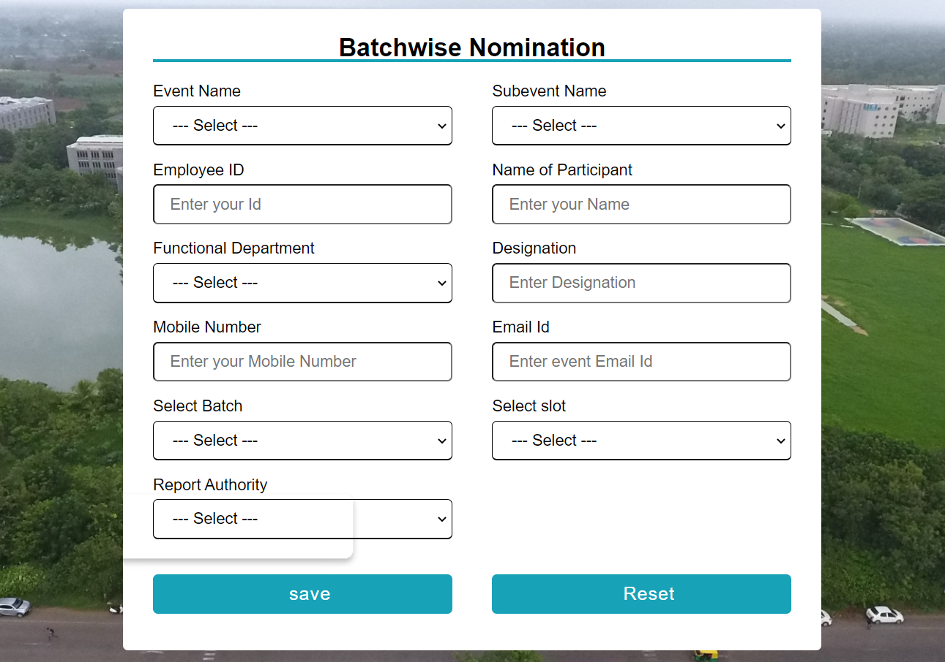

Slide 9
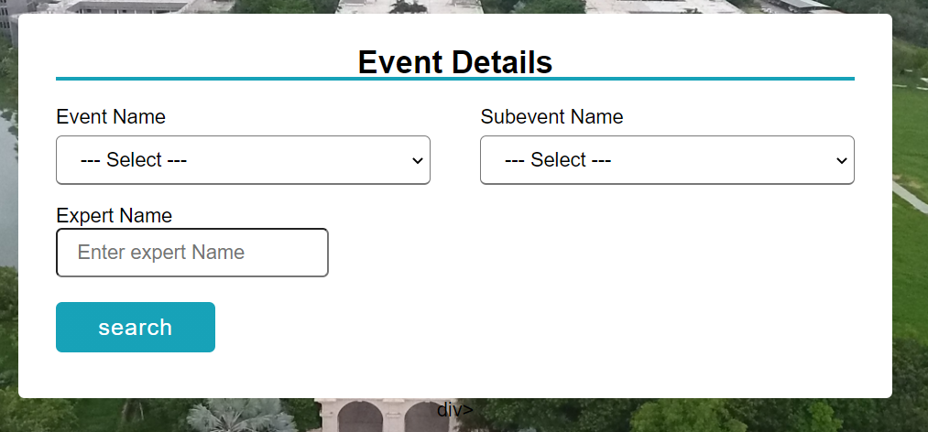
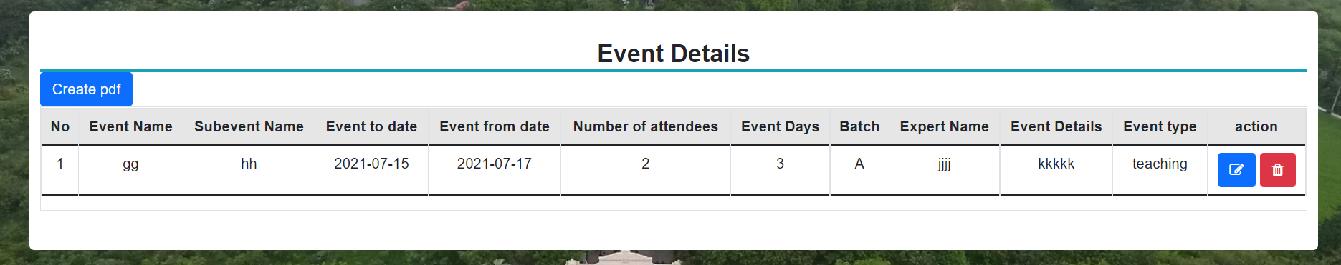

Slide 10
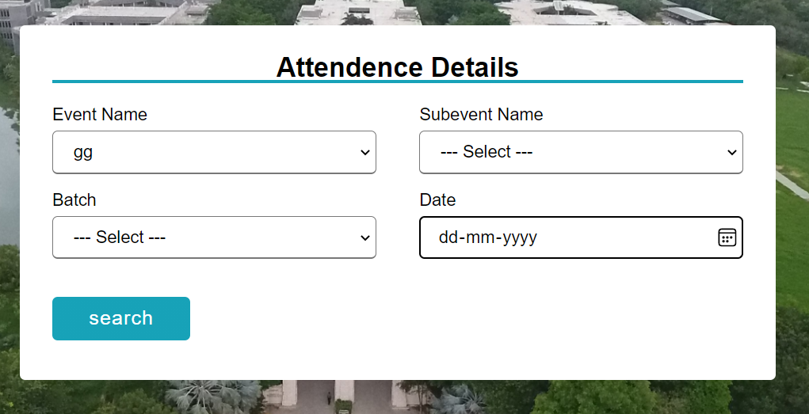
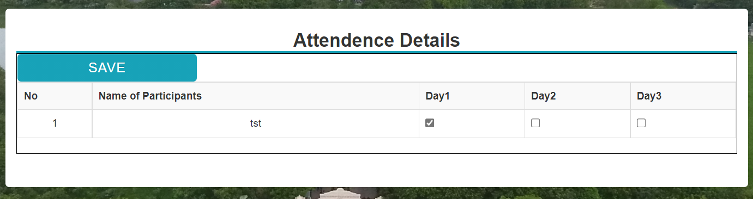

Slide 11
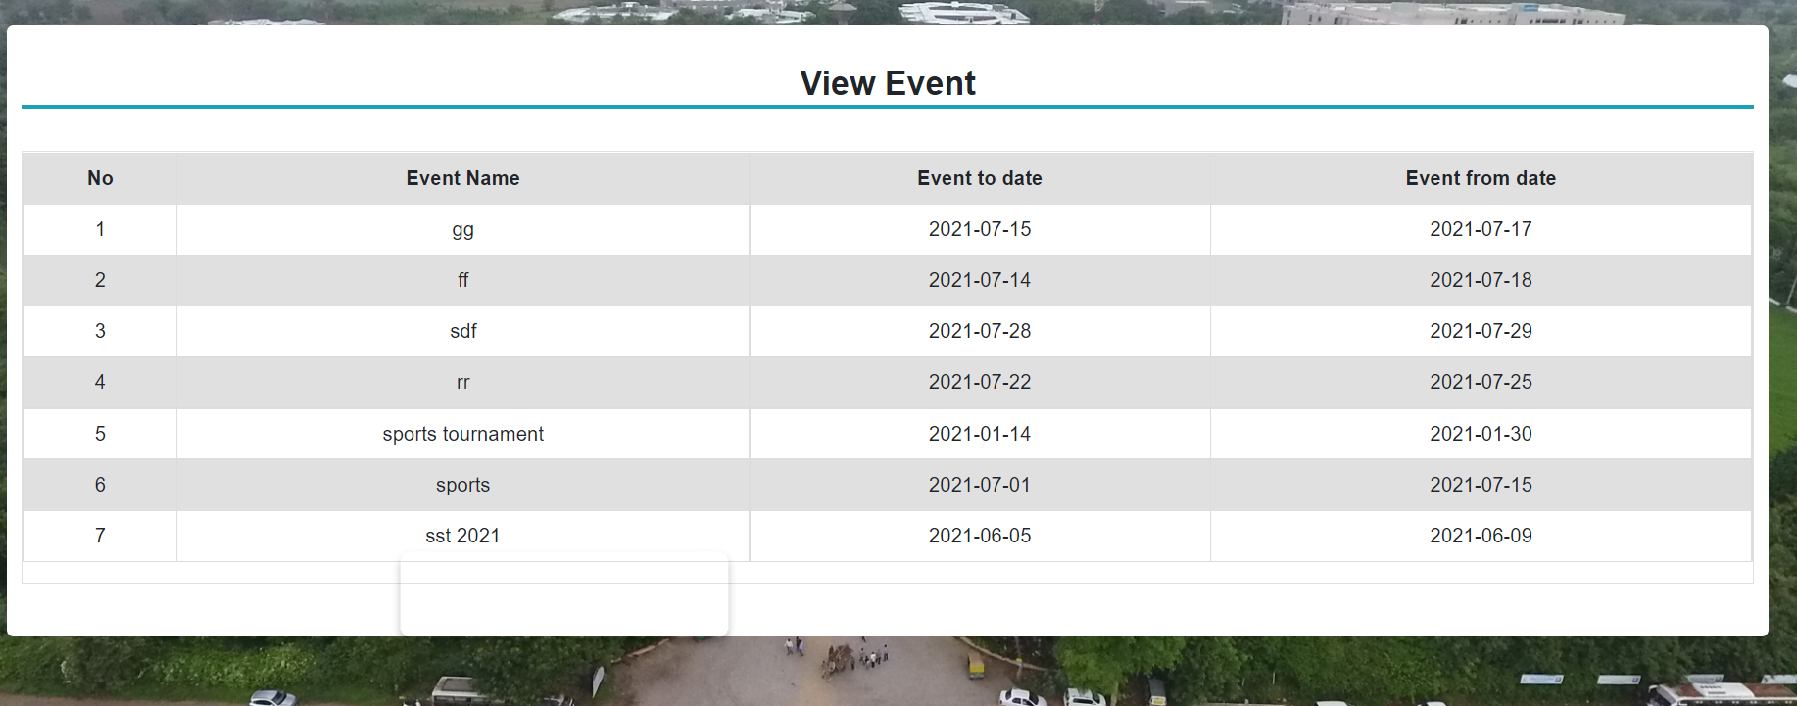

Slide 12
FUTURE ENHANCEMENTS
Make it Responsive
More Efficient
User friendly
Attendence management Improve
Pdf Improve

Slide 13
THANK YOU!

